Slide 1
THE ASSESSMENT OF ENTREPRENEURIAL OPPORTUNITIES
Lecture 9

Slide 2
THE ELEMENTS OF AN OPPORTUNITY ASSESSMENT
It is very crucial to assess whether an innovative idea is truly a feasible opportunity worth pursuing for commercialization or not.
Success depends on three key factors:
characteristics of the entrepreneur – personal reasons and motivations for start-up;
characteristics of the opportunity such as trends, risks, market size and resource availability; and
the nature of the venture itself – differing scalability, growth potential and performance.

Slide 3
THE ELEMENTS OF AN OPPORTUNITY ASSESSMENT
Theory of alertness asserts that entrepreneurs are opportunity identifiers who can spot unexploited market niches in advance of other people.
Entrepreneurs should examine the available information that supports an idea alongside simultaneously accessing social networks to better inform and shape the idea into an opportunity.
Opportunities differ across markets, technologies and situational contexts while the perception of opportunities can differ among individuals, depending on factors like gender, emotional state and self-confidence.

Slide 4
HOW DO WE MODEL THE ENTREPRENEURIAL PROCESS?
Ideas come relatively easily than identifying an entrepreneurial opportunity – ‘an idea which resolves a problem or adds value for customers and they are willing to pay for it.’
Opportunity recognition is more a creative and intuitive process than a scientific analysis.
People find opportunities more often in industries with which they are familiar or have a natural aptitude for.

Slide 5
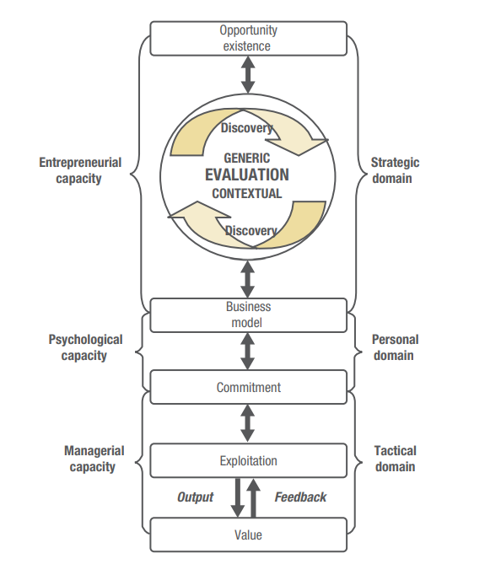
HOW DO WE MODEL THE ENTREPRENEURIAL PROCESS?

Slide 6
HOW DO WE MODEL THE ENTREPRENEURIAL PROCESS?
The entrepreneurial process includes three interrelated domains of activity (on right):
the strategic;
the personal; and
the tactical.
Each domain requires a distinctive capacity (on left):
entrepreneurial capacity - evaluating the opportunity and developing the business model;
psychological capacity - behaviors and commitment; and
managerial capacity - such as accounting and marketing.

Slide 7
HOW TO ASSESS AN OPPORTUNITY
Five critical factors in opportunity assessment are:
Uniqueness
Will new products, new technology, and new markets be required?
Investment
What is the required size of investment and timing of funds to move through the venture process?

Slide 8
HOW TO ASSESS AN OPPORTUNITY
Growth of sales
What is the growth pattern anticipated for new-venture sales and profits?
Product availability
Is a saleable good or service available in its finished form, at the time the venture opens its doors?
Customer availability
Are the customers available who are willing to pay for good or service?

Slide 9
WHEN IS AN IDEA NOT AN OPPORTUNITY?
The following are seven most common pitfalls encountered in the process of assessing whether a new venture idea is an opportunity:
Lack of objective evaluation
No real insight into the market
Inadequate understanding of technical requirements
Poor financial understanding
Lack of venture uniqueness
Ignorance of legal and regulatory issues
Lack of insight regarding industry structure

Slide 10
THE EVALUATION PROCESS
ANALYSING THE OPPORTUNITY LANDSCAPE:
PESTLE (Political, Economic, Sociocultural, Technological, Legal and Environmental) analysis is used to:
locate the source of the opportunity or the changing conditions that present the opportunity;
identify the size of the likely market needs that may arise from these changing conditions;
identify the likely duration of the need and how the conditions will influence the timing of the opportunity;
locate the trends which create new needs and may show how the need will increase or decrease over time; and
indicate the emerging issues, values or lifestyles which uncover emerging needs.

Slide 11
THE EVALUATION PROCESS
ASSESSING THE INDUSTRY ENVIRONMENT
What is the structure of the industry and how is it likely to evolve over time?
If the entrepreneur’s business is not in an attractive industry then the person may want to get out of it or redefine it.
What is the company’s relative position in the industry?
Entrepreneur will not do well if his company does not hold a good position in an attractive industry. Conversely, the business can be in a lacklustre industry with low average profitability, yet if it occupies exactly the right niche it can perform well.

Slide 12
THE EVALUATION PROCESS
UNCERTAINTY ANALYSIS: Unlike risks, there is little one can do to mitigate uncertainty as there is no past experience of it to rely on.
Technological uncertainty
Continuous technological advancements present great uncertainty in almost every industry.
Strategic uncertainty
Since no ‘right’ strategy exists, industry participants will formulate different approaches to product positioning, advertising, pricing, etc.

Slide 13
THE EVALUATION PROCESS
First-time buyer uncertainty
Careful marketing effort is required to make the buyer the initial purchase of the new product or service.
Short-time horizon and strategic uncertainty
Short-run results are often given major attention, while long-run results are given little consideration, creating strategic uncertainty.

Slide 14

THE EVALUATION PROCESS
VALUE CHAIN ANALYSIS
Any business is set within an industry value chain.
Each link in the chain must be able to purchase its supplies and sell its goods or services at a profit margin that enables the whole chain to produce, distribute and deliver the good/service to the end user at a price the end user is willing to pay.

Slide 15
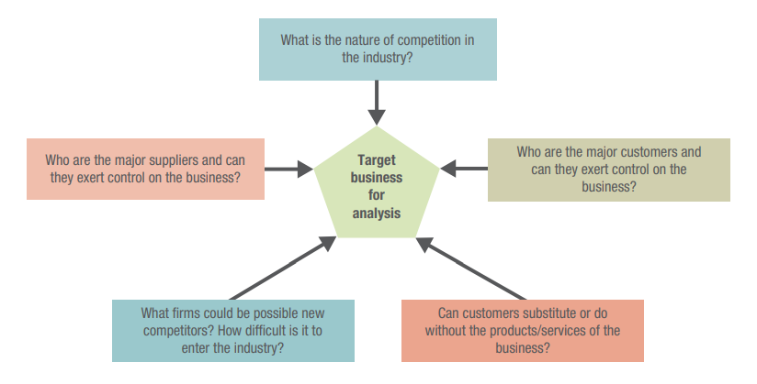
THE EVALUATION PROCESS
PORTER’S FIVE FORCES MODEL

Slide 16
THE EVALUATION PROCESS
PROFILE ANALYSIS
It works with an internal focus to determine the resources available to a new venture.
A checklist approach is followed which allows entrepreneurs to identify major strengths and weaknesses in the financial, marketing, organizational and human resource factors needed for the venture to progress successfully.
The analysis can help avoid many external threats.

Slide 17
THE EVALUATION PROCESS
FEASIBILITY CRITERIA ANALYSIS
Are the initial production costs realistic?
Are the initial marketing costs realistic?
Does the product have potential for very high margins?
Is the time required to get to market and to reach the break-even point realistic?
Is the potential market sufficiently large?
Is the product the first of a growing family?
Do initial customers exist?
Are the development costs and calendar times realistic?
Is this a growing industry?
Can the product – and the need for it – be understood by the financial community?

Slide 18
THE EMERGENCE OF ENTREPRENEURIAL ECOSYSTEMS
Entrepreneurs are most successful when they have access to the human, financial and professional resources they need, and operate in an environment in which policies encourage and safeguard entrepreneurs. This network is described as the ‘entrepreneurship ecosystem.’

Slide 19
THE EMERGENCE OF ENTREPRENEURIAL ECOSYSTEMS
A supportive environment makes entrepreneurs to find:
an abundance of experience to draw upon for decision making support;
a more willing and open capital market for technology ideas;
stronger bonds between industry and universities; and
a culture that wonders what’s wrong with you if you’re not starting a company rather than wondering why you would bother.

Slide 20
THANKS

Slide 21
REFERENCES
Entrepreneurship: Theory/Process/Practice 4th Edition Howard Frederick, Allan O’Connor, Donald F. Kuratko

